Slide 1


Insect-IMP
Insect-IMPImproved Knowledge Transfer for Sustainable Insect Breeding
Špela Kodre, Diseminacija in komunikacija
spela.kodre@kis.si
www.cost-insectimp.eu I info@cost-insectimp.eu

Slide 2

Insect-IMP
Insect-IMPImproved Knowledge Transfer for Sustainable Insect Breeding
Špela Kodre, Diseminacija in komunikacija
spela.kodre@kis.si
www.cost-insectimp.eu I info@cost-insectimp.eu

Slide 3


Enhance food security sustainably through insect genetics, minimizing environmental impact
Špela Kodre, Diseminacija in komunikacija
spela.kodre@kis.si
www.cost-insectimp.eu I info@cost-insectimp.eu

Slide 4


Thank you!
www.cost-insectimp.eu I info@cost-insectimp.eu
Follow us:

Slide 5



Thank you!
www.cost-insectimp.eu I info@cost-insectimp.eu
Follow us:

Slide 6

Presentation title
Insect breeding, an exciting young field in animal production, is seeing growth, but slow overall improvements.
Despite its growing importance, the industry lacks a cohesive platform for collaboration due to factors such as competition for funding, limited supply contracts, and a lack of publicly available information supporting the development of insect breeding schemes.
28%
Annually Growth
$9.60 billion
Insect market
400K
Another number

Slide 7

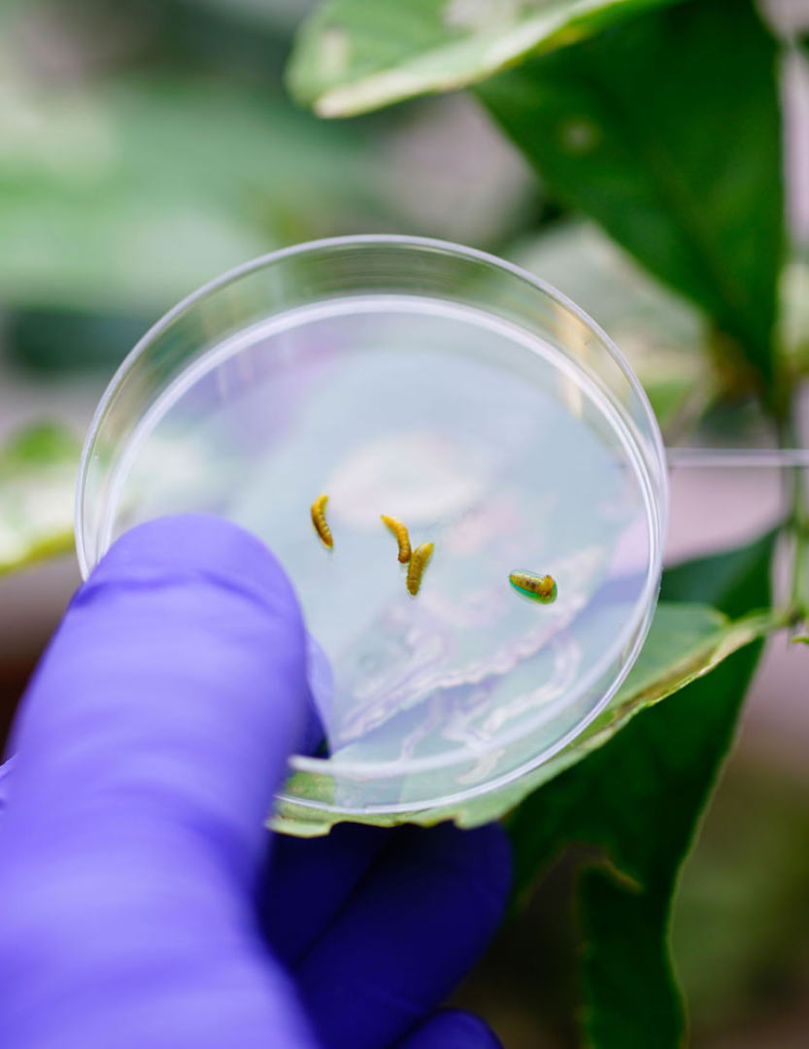

How can I participate?
The global population is expected to increase to 10 billion by 2050, bringing with it an increased demand for food and specifically protein.
Insect farming can play a major role in ensuring global food security, reducing the environmental footprint of food production, and increasing sustainability of modern farming systems.
However, it is currently relying on insect populations whose genetics are poorly understood and who are not necessarily bred- or even fit-for-purpose.

Slide 8
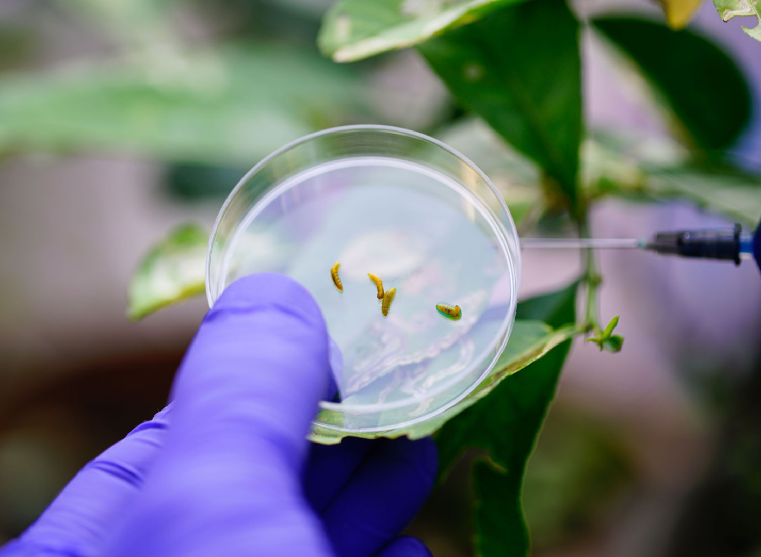


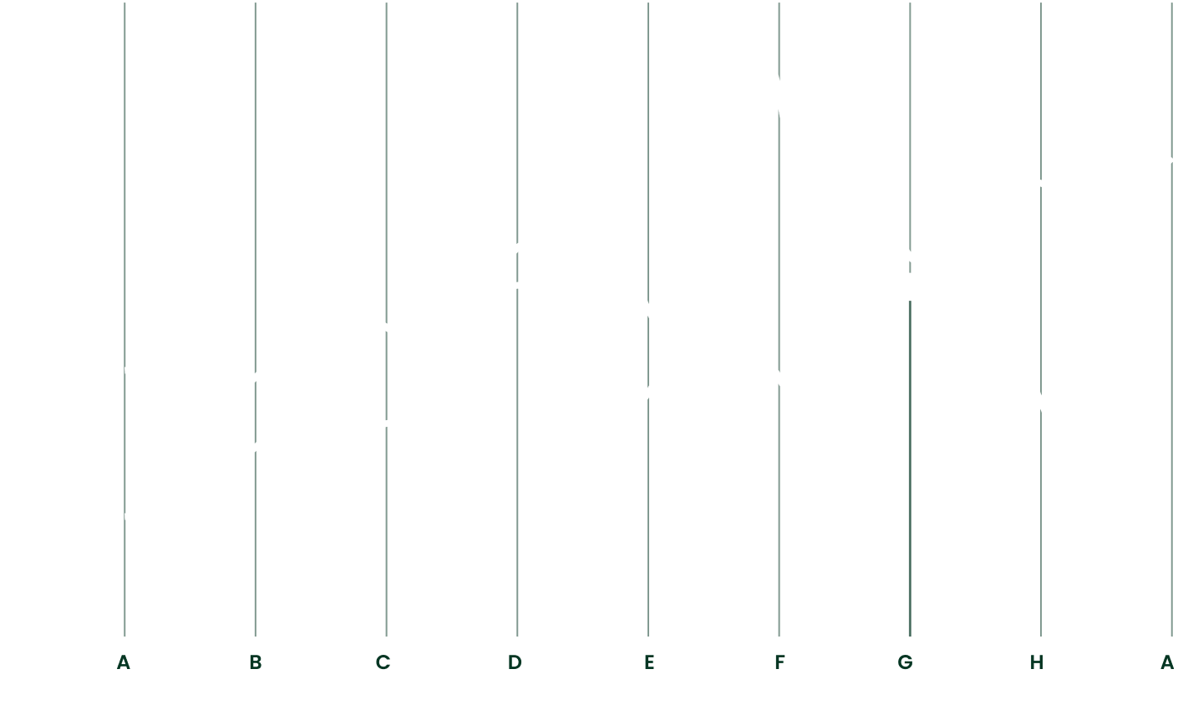
Improved Knowledge Transfer for Sustainable Insect Breeding
75
50
25
expected to increase to 10 billion by 2050, bringing with it an increased demand for food and specifically protein.
0

Slide 9

CHAPTER 01
Lorem Dolor Title
100
The global population
75
expected to increase to 10 billion by 2050, bringing with it an increased demand for food and specifically protein.
50
The global population
expected to increase to 10 billion by 2050, bringing with it an increased demand for food and specifically protein.
25
The global population
expected to increase to 10 billion by 2050, bringing with it an increased demand for food and specifically protein.
0
JAN
FEB
MAR
APR
MAY
JUN

Slide 10


CHAPTER 01
Lorem Dolor Title
The global population is expected to increase to 10 billion by 2050, bringing with it an increased demand for food and specifically protein.
Insect farming can play a major role in ensuring global food security, reducing the environmental footprint of food production, and increasing sustainability of modern farming systems.
However, it is currently relying on insect populations whose genetics are poorly understood and who are not necessarily bred- or even fit-for-purpose.

Slide 11
CHAPTER 01
Lorem Dolor Title
The global population is expected to increase to 10 billion by 2050, bringing with it an increased demand for food and specifically protein.
Insect farming can play a major role in ensuring global food security, reducing the environmental footprint of food production, and increasing sustainability of modern farming systems.
However, it is currently relying on insect populations whose genetics are poorly understood and who are not necessarily bred- or even fit-for-purpose.
Insect farming can play a major role in ensuring global food security, reducing the environmental footprint of food production, and increasing sustainability of modern farming systems.

Slide 12
CHAPTER 01
Lorem Dolor Title
The global population is expected to increase to 10 billion by 2050, bringing with it an increased demand for food and specifically protein.
Insect farming can play a major role in ensuring global food security, reducing the environmental footprint of food production, and increasing sustainability of modern farming systems.
However, it is currently relying on insect populations whose genetics are poorly understood and who are not necessarily bred- or even fit-for-purpose.
The global population is expected to increase to 10 billion by 2050, bringing with it an increased demand for food and specifically protein.
Insect farming can play a major role in ensuring global food security, reducing the environmental footprint of food production, and increasing sustainability of modern farming systems.
However, it is currently relying on insect populations whose genetics are poorly understood and who are not necessarily bred- or even fit-for-purpose.

Slide 13
WORKING GROUPS
WG1: Population structure
Poorly understood population structure
Insects are seldom “picked”-, fit- or bred-for-purpose
No information on the effect of “domestication” or cultivation
ROLE
Coordinate genotyping efforts
Consolidate work on population structure and effect of domestication

Slide 14




CHAPTER 01
Lorem Dolor Title
Title Placeholder
Title Placeholder
Title Placeholder
expected to increase to 10 billion by 2050, bringing with it an increased demand for food and specifically protein.
expected to increase to 10 billion by 2050, bringing with it an increased demand for food and specifically protein.
expected to increase to 10 billion by 2050, bringing with it an increased demand for food and specifically protein.
expected to increase to 10 billion by 2050, bringing with it an increased demand for food and specifically protein.

Slide 15

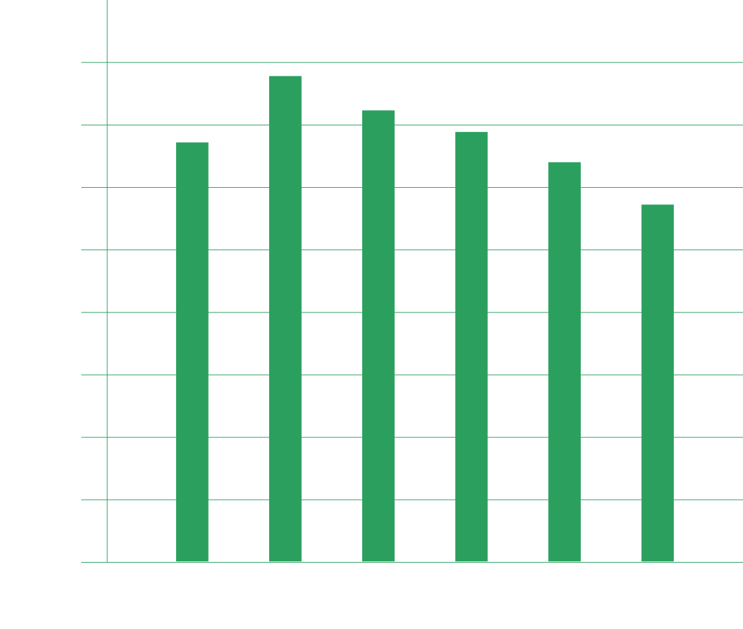




Lorem Dolor Title
100
Read the Project Description MoU
Inform the Main Proposer/Chair of your interest (email)
Apply to join your Working Groups of interest
Please note, Management Committee nominations are carried out through the COST National Contact Points
75
50
25
0
JAN
FEB
MAR
APR
MAY
JUN
25%
42%
50%
18%

